Slide 1
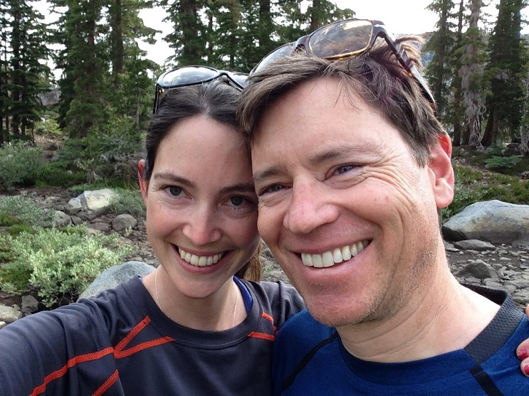
Megan Rippy
Assistant Professor in CEE at Virginia Tech: Ecological Engineer
Born in Northern California, but recently moved to Virginia for work
Background in Ecology
BS and MS in Marine Biology (population genetics) &
PhD in Biological Oceanography from the Scripps Institution of Oceanography
Background in Environmental Engineering and Social Ecology (Postdoctoral work at the University of California Irvine)

Slide 2
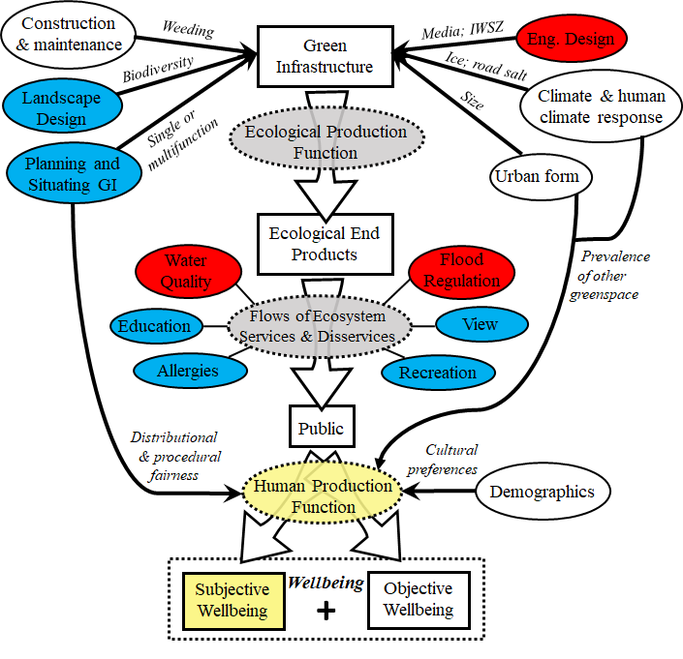
Multifunctional Green Stormwater Infrastructure: Ecosystem Services Provisioning
Social, Ecological, and Engineering Drivers
Within-system ecological process
Multiple Services
Human processing of services (HWBF)
Perception that services are provided
Probability Density

