Slide 1
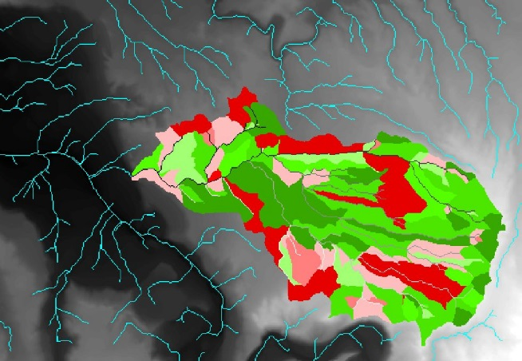
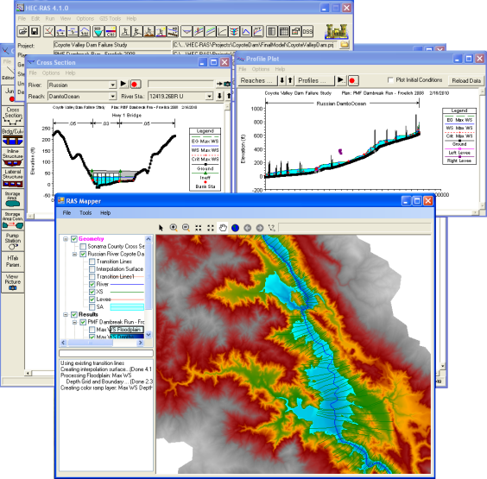
Assessing the Effects of Soil Distribution on Flood Modeling using a Combination of a Hydrologic and a Hydraulic Model
✓ Hydrologic Model
- GeoWEPP
(Geo-spatial Interface for WEPP)
✓ Hydraulic Model
- HEC-RAS
(Hydraulic Engineering Centers
– River Analysis System)

Slide 2
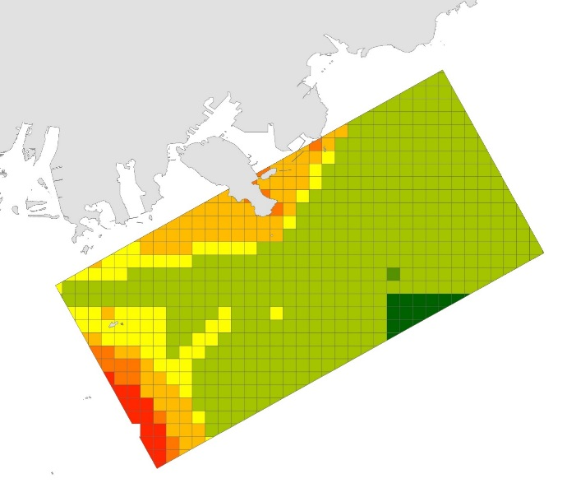
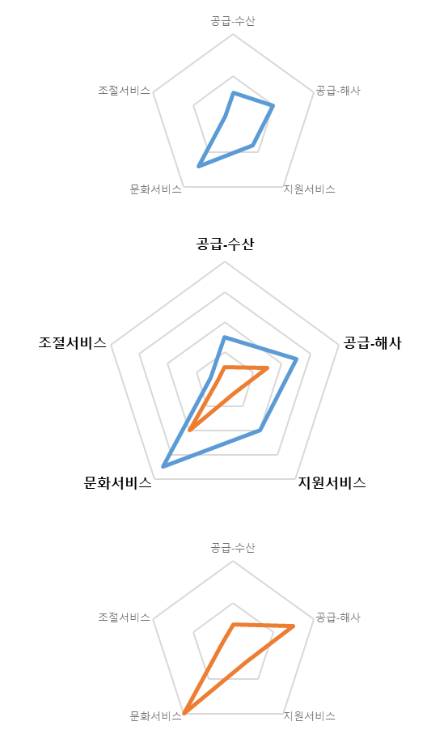
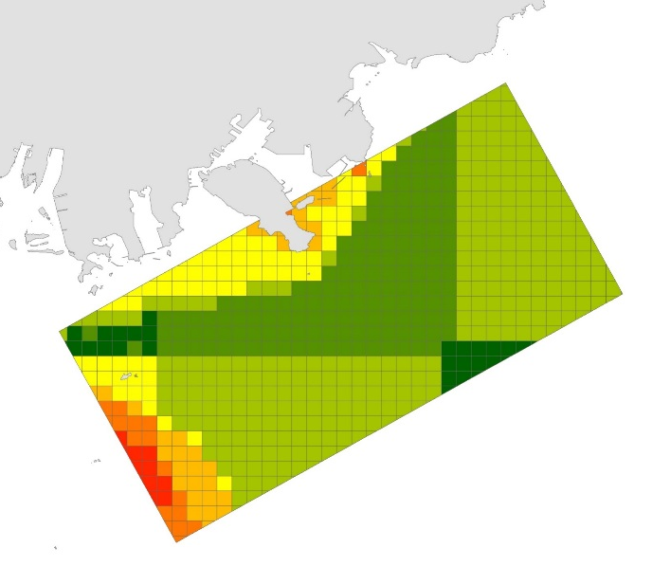
Marine Ecosystem-based Analysis and
Decision-making Support System Development
Valuation of Ecosystem Services
Trade-off between Ecosystem Services
Quantification of Trade-offs
MES (Present)
Services |  | Value
Prov. | Fisheries | 0.3
 | Aggregate | 0.5
Supporting |  | 0.4
Cultural |  | 0.7
Regulating |  | 0.1
Total |  | 2
Prov. - Fisheries
Supporting
Prov. -
Aggregate
MES (Expected)
Services |  | Value
Prov. | Fisheries | 0.1
 | Aggregate | 0.3
Supporting |  | 0.1
Cultural |  | 0.4
Regulating |  | 0.05
Total |  | 0.95
Cultural
Regulating

