Slide 1
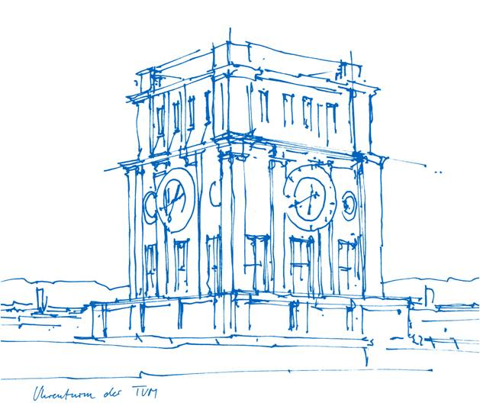
Francesca Perosa, M.Sc.
Research Assistant / PhD Candidate
@ Technical University of Munich
Chair of Hydrology and River Basin Management (Prof. Disse)
1992: Born in Udine, Italy
2011-2014: Bachelor in Environmental Engineering
@ University of Trento
2015-2017: Master in Environmental Engineering – Field of Study: Environmental Hazards and Resources Management
@ Technical University of Munich
Since September 2018: working on ES
Interreg Danube Floodplain project
@ Technical University of Munich
2
1
3
1: www.freefarma.it
2: www.ricettegourmet.com
3: modified from „waving” by Arthur Shlain from the Noun Project

Slide 2
Interreg Danube Floodplain
Aims:
Reducing the flood risk through floodplain restoration along the Danube River
Evaluating restoration scenarios through cost-benefit analysis (CBA) in 5 pilot areas
Pilot areas | CZ/SK, HU, RO, RS, SI
Size [ha] | 1000 - 20000
Motivation | Flood risk, cultural heritage, protected areas, (wetlands, flood forests, etc.), pollution
Land cover | Arable land (non-irrigated), broad-leaved forest, pastures, inland marshes
Restoration measures | Dike relocation/removal, weir removal, reconnect oxbows, afforestation, meandering, etc.
Habitat modeling
2D hydraulic modeling
ES analysis
Extended CBA
ES assessment
ES valuation
From:
Danube Floodplain Factshet

