Slide 1
ABOUT MYSELF….
FABIAN HERNANDEZ RAMOS
CURRENT RESEARCH INTEREST
Mapping and modelling ecosystem services (Supply and demand) of forests.
Usability of ARIES at different territorial scales
Born in Bogotá in 1992
Bachelor degree in Forestry Engineering
Specialization in GIS – Universidad Distrital Francisco José de Caldas
Master student in Management, use and conservation of forests - Universidad Distrital Francisco José de Caldas

Slide 2
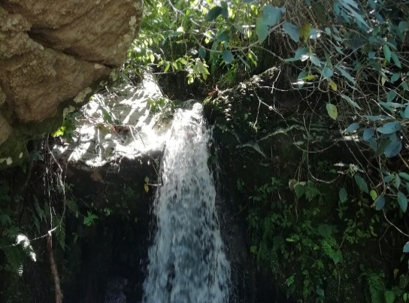
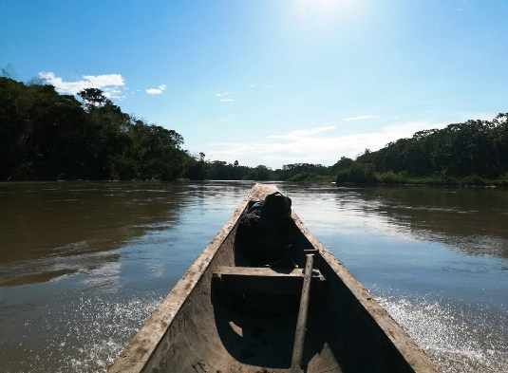
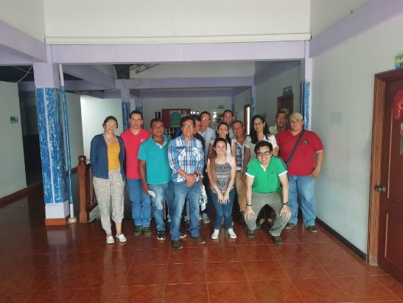
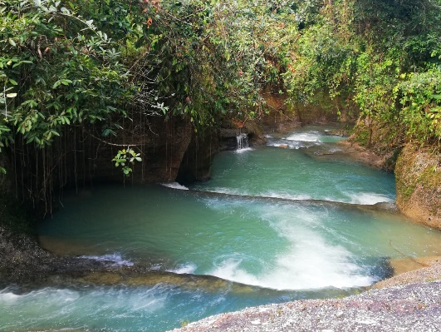
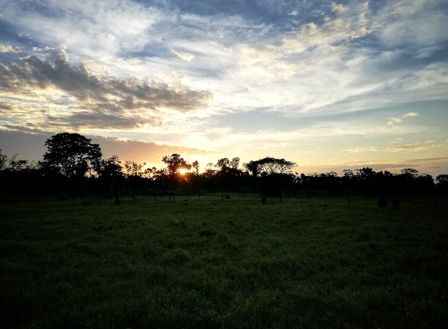
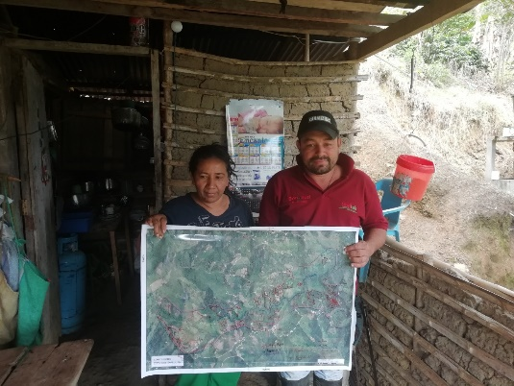
CURRENT RESEARCH INTEREST
EXPERIENCE FIELD
Trajectory (over 3 years) in the field of consultancy on land planning in Colombia like:
Land use changes, Floristic characterization
POMCAS: Planning and management of watersheds
POF: Forest management plan
Participatory zoning ( in the framework of the peace agreement in Colombia)

